Slide 1

MyLegion My Groups:
Online Membership Processing
Transmit member renewals, add new members and transfer members.
2025

Slide 2
Online Membership Processing
Payment information is entered when finalizing the first transmittal and stored for future batches. A second transmittal cannot be finalized until the first one completes to ensure stored payment information is valid.
Open batches must be finalized within 14 days, or it will be removed, and a new batch will need to be created.
Pending transmittals in process must complete prior to making any adjustments. Renewing a member for the incorrect membership year or any other adjustments are reported to your department.
Notes:
Important information to know about online membership processing.
Payment information is entered when finalizing the first transmittal and stored for future batches. A second transmittal cannot be finalized until the first completes. This hold is to ensure payment information is stored correctly and to prevent multiple declines. Attempting to finalize a transmittal prior to the first one completing will result in an error message. This hold is activated each time new bank information is entered.
<1> Open batches are to be finalized within 14 days. Reminders to submit are emailed to adjutants and are deleted if no action is taken. All members in the transmittal will have to be re-entered in a new batch.
<2> Pending transmittals in process must complete before any adjustments can be made. Renewing a member for the incorrect membership year or any other adjustments are to be reported to your department.

Slide 3
Online Membership Processing
Transmittals complete an average of 10-12 days. Member records are updated when posted. Review transmittal history to view batch status.
$10,000 batch limit.
Stored bank information can be updated when finalizing a transmittal. On the payment window, select “Update Account Information”.
Notes:
Current processing time is 10-12 days. Member records are updated when the batch is posted. Review transmittal history to view batch status.
<1> There is a $10,000 batch limit. Amounts higher than that should be broken down to separate transmittals that meet the limit.
<2> Stored bank information can be updated when finalizing a transmittal. On the payment window, select “Update Account Information”.

Slide 4
Online Membership Processing
Declined transmittal notifications are sent to adjutants. Declined batches can be resubmitted. Contact myLegion support for questions regarding declined batches.
Available for posts, squadrons, detachments and departments. District and County groups do not have online membership processing.
Notes:
Declined batches can be resubmitted. Contact myLegion support for questions regarding declined batches.
<1> Online membership processing is available for posts, squadrons, detachments and departments. Distirct and County groups do not have this feature.

Slide 5
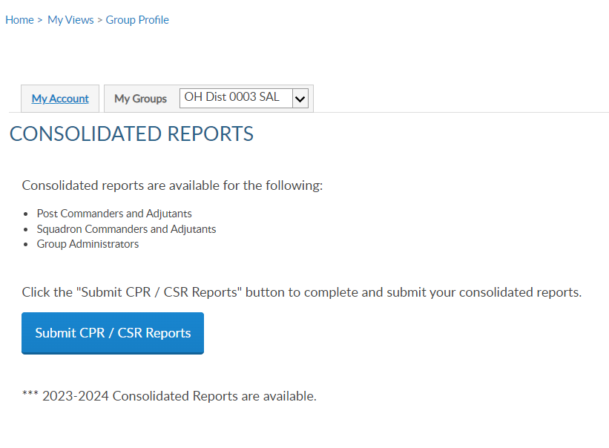
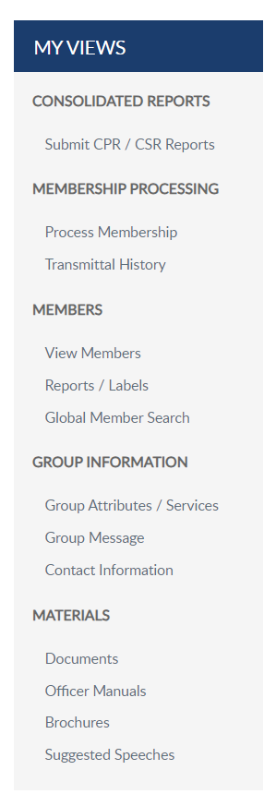

GROUP PROFILE
Notes:
Create a transmittal by going to Process Membership. You can also access membership processing through View Members. Either option opens the Members window.
In this example, we will add and finalize a squadron transmittal. The squadron is selected in group menu, click Process Membership.

Slide 6
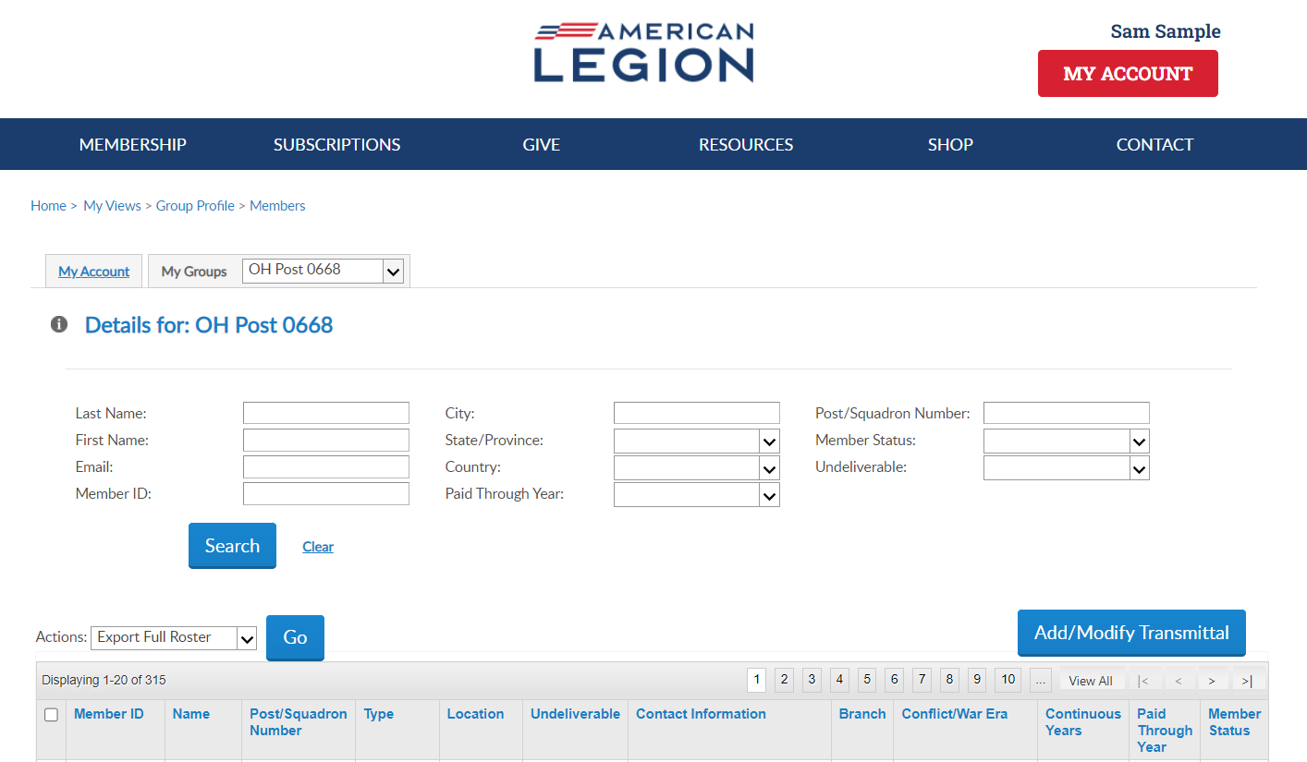
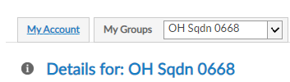
Online Help
Notes:
The members window allows you to search and view members. The list includes all members, active and deceased with a last paid years for current and expired members.

Slide 7
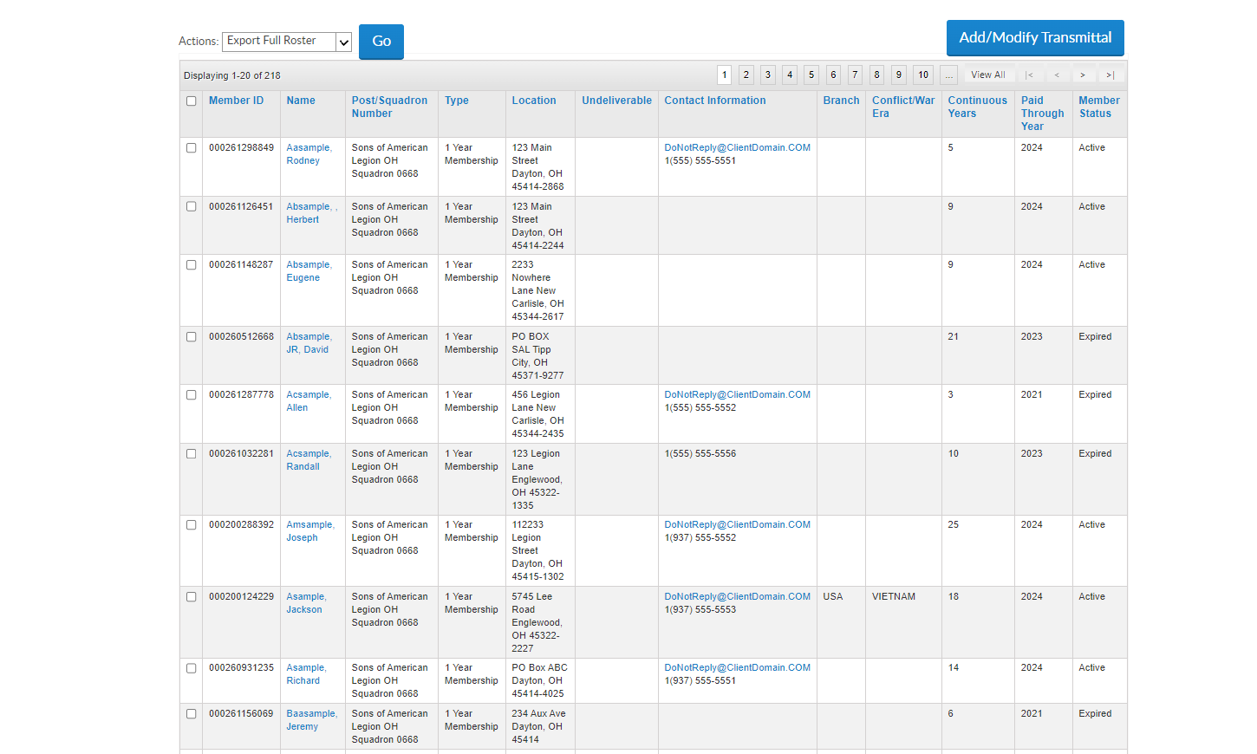
View Members
123456789
2025
122333445
2025
122333444
2025
122333222
2024
122333555
2022
122333400
2024
122333454
2025
122331250
2025
122332251
2025
111331250
2022
Notes:
Notice in this listing displays the Paid Through Year. Members paid for the current membership year are not eligible for renewal and will not be in renewal list. To begin a transmittal, click “Add/Modify Transmittal”. <1>

Slide 8
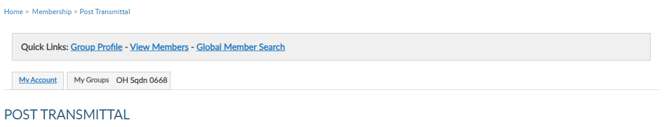
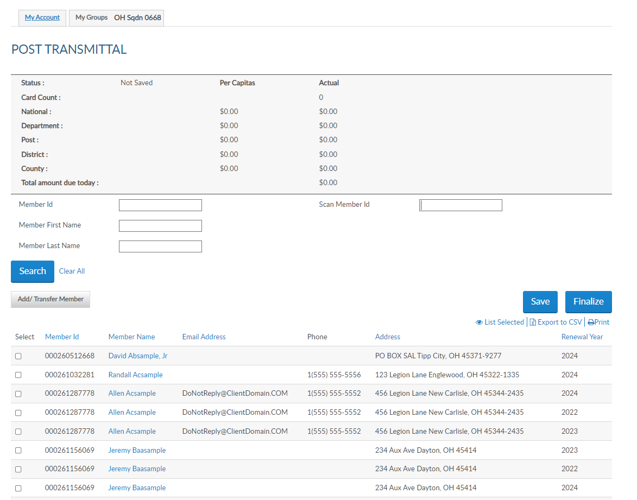
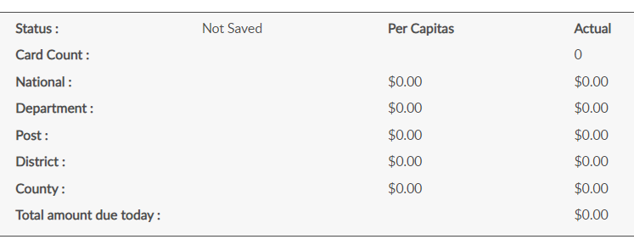
Transmittal Summary
Squadron Transmittal
122333222
122333400
122333555
122333555
122333555
122333332
122333332
122333332
Notes:
The squadron transmittal page open to begin adding members to the batch. The transmittal summary includes transmittal status, number of cards, and per capita allocations. Total amount includes national and detachment only. These amounts do not display until a member is added to the batch, The summary area recalculates with each entry.

Slide 9
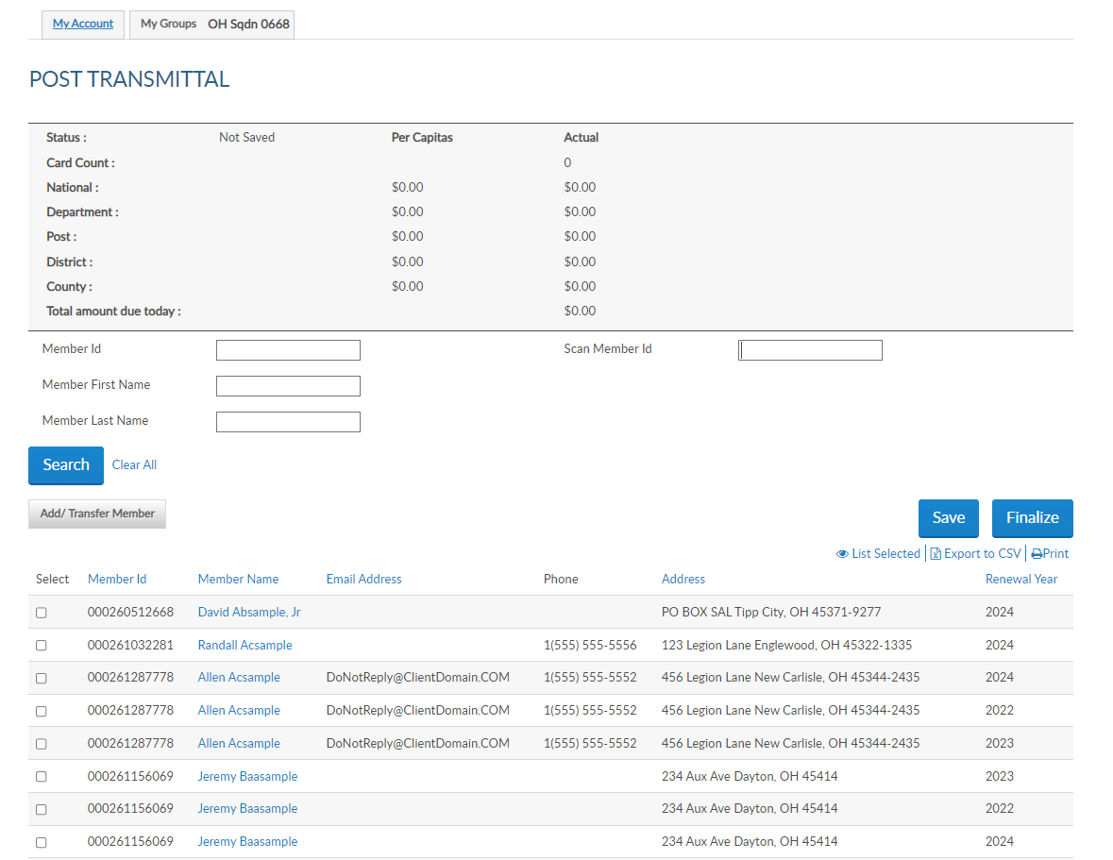
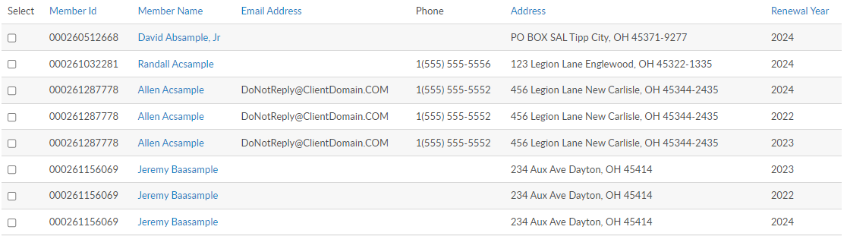
122333222
2025
122333400
2025
122333555
122333222
2025
A
122333555
122333400
2024
122333555
122333555
122333555
111331250
122333555
111331250
122333332
122333332
2025
111331250
122333332
Notes:
The listing in transmittal only displays names of members eligible for renewal. <1> Members with more than one eligible renewal year will have a line for each eligible renewal year as in Sample A. Current paid members will not display in this listing.
The renewal list is alphabetic. To add a member to the batch, select the box for the correct renewal year.

Slide 10
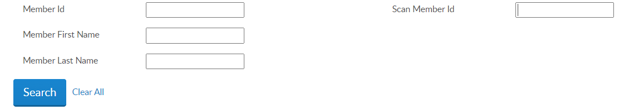

Renew Members
122333222
2025
122333400
2025
122333555
122333222
2025
122333555
122333400
2024
122333555
122333555
122333555
111331250
122333555
111331250
122333332
122333332
2025
111331250
122333332
Notes:
You can search a member by ID or name.
The scan member ID field is for detachments and large squadrons using bar code scanners. This allows you to scan the barcode from the membership card to auto enter in the field. The 'Scan Member Id' box only applies to the current membership year and saves the record to the batch. However, you don't have to use a scanner to utilize the "Scan Member Id" box; you can just type the ID and hit enter and it will add the member to the transmittal.
If you do not find the member to renew, the member is either already paid, in a pending transmittal, transferred out of your squadron, or expired for greater than 2 years. Tools available to determine the members status are located in Transmittal History, Current Roster, and Roster Updates.

Slide 11
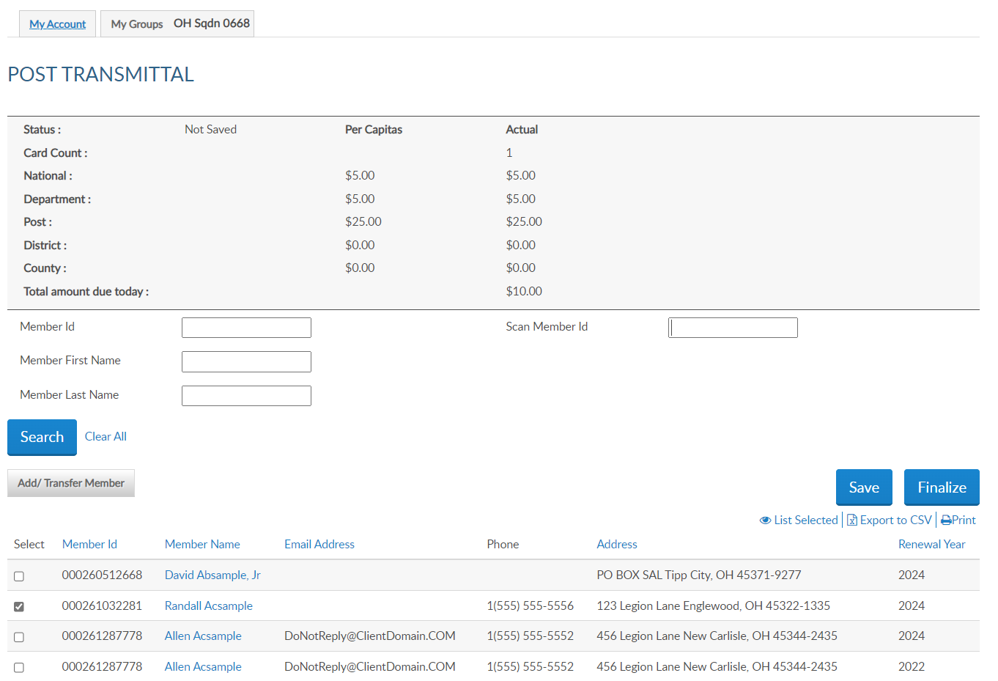
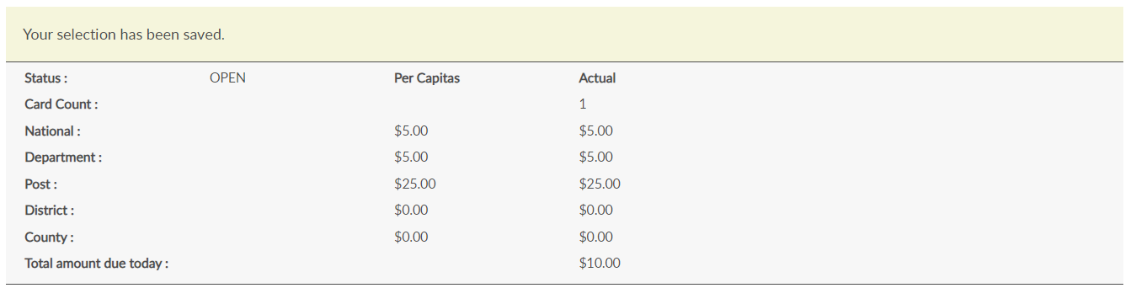
122333222
2025
122333400
2025
122333555
2025
122333555
2024
Notes:
Always save your batch after adding records. Saving the batch updates the status to Open. Open batches must be finalized in 14 days, or it will be removed. The batch will have to be re-entered.
The member’s current year renewal is checked, adding the member to the batch. If the member is paying past dues, check the boxes for the renewal year. You can process more than one year renewal in the same batch. The batch summary amount due calculates with each member added to the batch. The total amount due equals the department and national per capita only.
Continue renewing members using search to check the renewal year. Save each entry as you go if not using scan member ID and when all names are added finalize the batch. Exiting this area without saving the batch will result in having to re-enter any entries made.

Slide 12

Add member
Add New Member
122333222
2025
122333400
2025
122333555
2025
122333555
2024
Notes:
To add a new member or transfer a member select the Add/Transfer Member button. <1> Let’s add a new member to the squadron.

Slide 13
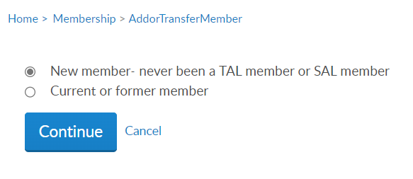
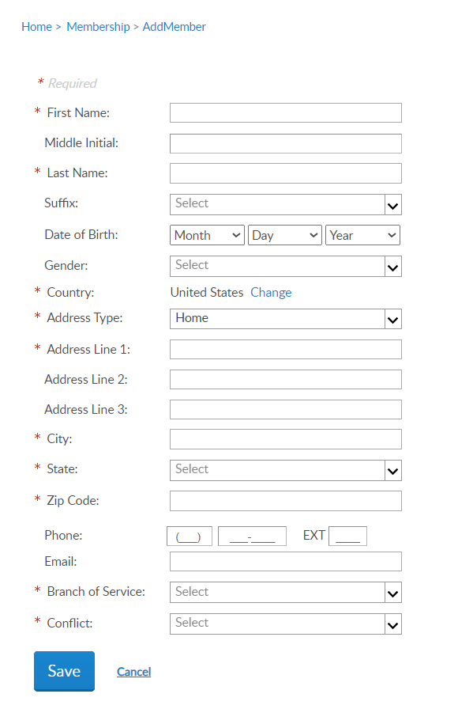
Online Help
Notes:
Select “new member – never been an American Legion or Sons of the American Legion member and click continue.
Enter the member’s information and Save. Fields with an asterisk are required. To enter a foreign address, use the pulldown menu in country, to select country.

Slide 14
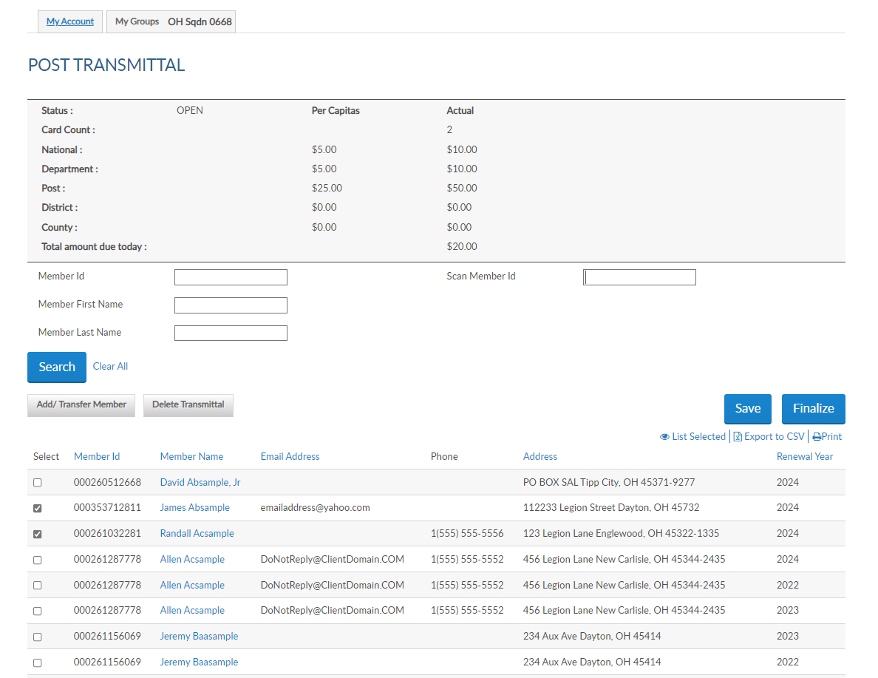
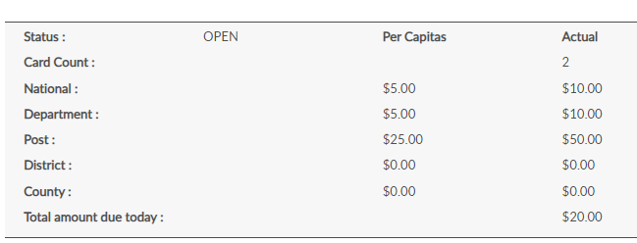
New Member
122333222
351222333
122333400
122333555
122333555
122333555
122333332
122333332
Notes:
The new member is added to the list and the summary updates. New members will appear on your member listing with 0 continuous years until the batch completes.
Save each entry to prevent losing members in the batch. Always save the batch before exiting.

Slide 15

Online Help
Member is deeply expired, and no renewal order exists.
New member created a MyLegion account prior to joining.
New member has a Legion membership.
Notes:
If you receive a message when adding a new member “A Customer exists with matching details with the member ID#” it is generally for the following reasons:
<1> The member is deeply expired, and no renewal order exists to fulfill, <2> the new member created a myLegion account prior to joining, or <3> the new member has a squadron membership. If this message appears, capture the ID number, click cancel to return to post transmittal, and process as current or former member.

Slide 16
Transfer member
Transfers can only be completed if the member is renewing dues in the same transaction.
Transfer current paid members through your detachment.
122333222
2025
351222333
2025
122333400
2025
122333555
2025
122333555
2024
122333555
2023
122333332
2025
122333332
2024
Notes:
The next transaction available using online membership processing is transferring members into your squadron. Only members that are renewing dues can be transferred online. To transfer paid members, complete a Member Data Form and send to your department.
<1> To transfer a renewing member, select Add/Transfer Member.

Slide 17
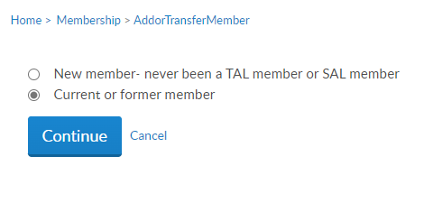
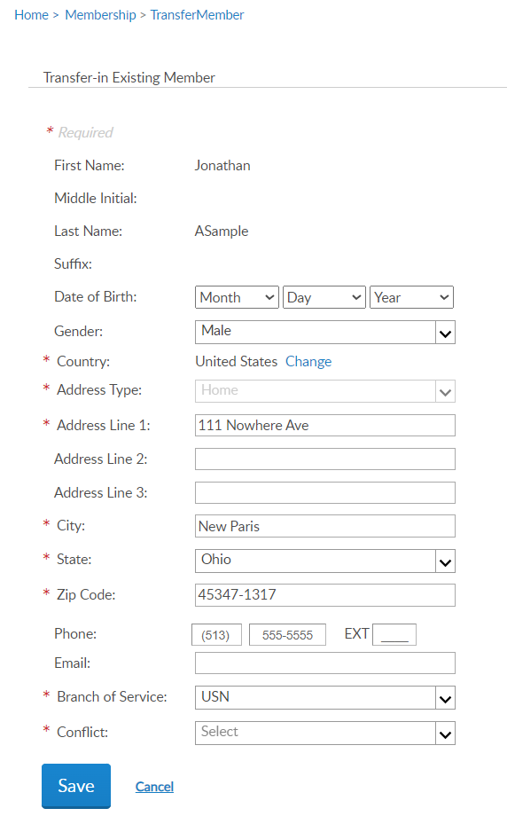
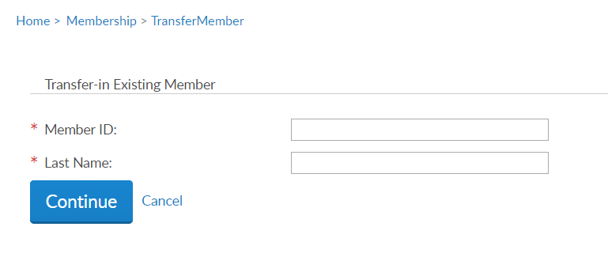
Online Help
Mitchell
Baasample
Notes:
Select current or former member and continue. <1> Enter the member ID# and last name and continue. <2>
Update any information needed and add any required data. Click Save to add the member to the batch.

Slide 18
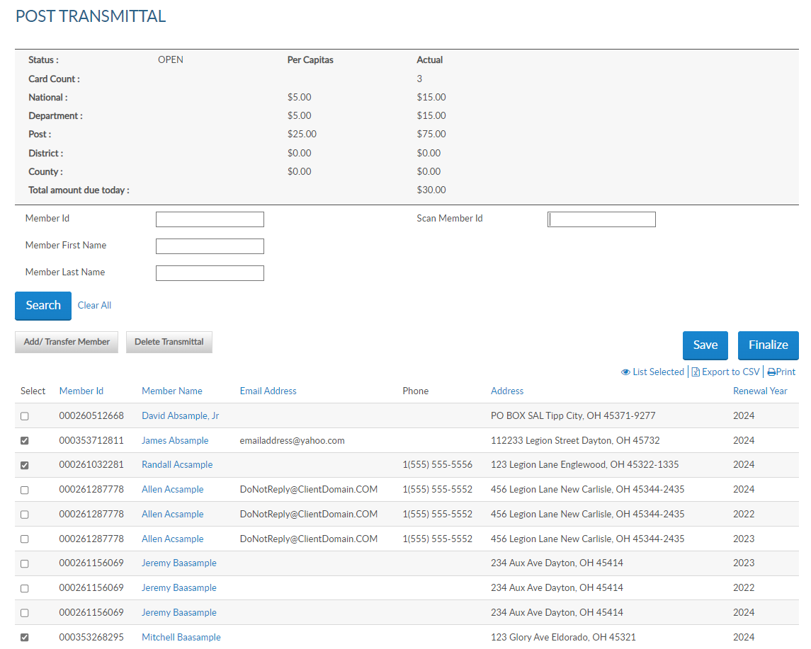
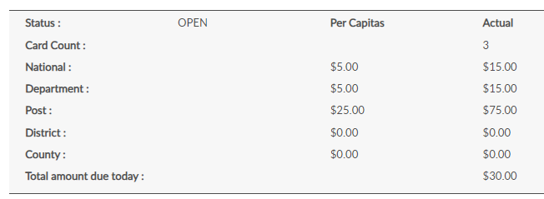

Online Help
122333222
2025
351222333
2025
122333400
2025
122333555
2025
122333555
2024
122333555
2023
Transferred Member
122333332
2023
122333332
2024
122333332
2023
124654123
2025
Notes:
The Summary recalculates with the total amount due. The amount due equals detachment plus national per capita.
To remove members from the transmittal, uncheck the box next to the name and the summary will recalculate. To delete the whole transmittal, select “Delete Transmittal”. <1>

Slide 19
List Selected
122333222
2025
351222333
2025
122333400
2025
122333555
2025
122333555
2024
122333555
2023
122333332
2023
122333332
2024
122333332
2023
124654123
2025
Notes:
After all records are entered you can view the batch by clicking “List Selected”. The Finalize button directs you to the same page. Payment information will be entered during finalization if not already stored.
Open batches must be finalized within 14-days or automatically be removed. The members will have to be re-entered.

Slide 20
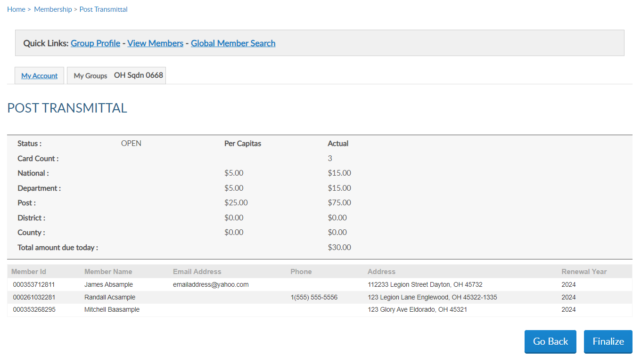
351222333
2025
122333400
2025
124654123
2025
Notes:
Selecting view list or finalize displays the members in the batch and the total amount due . Click finalize to continue or Go Back to return to transmittal list.

Slide 21
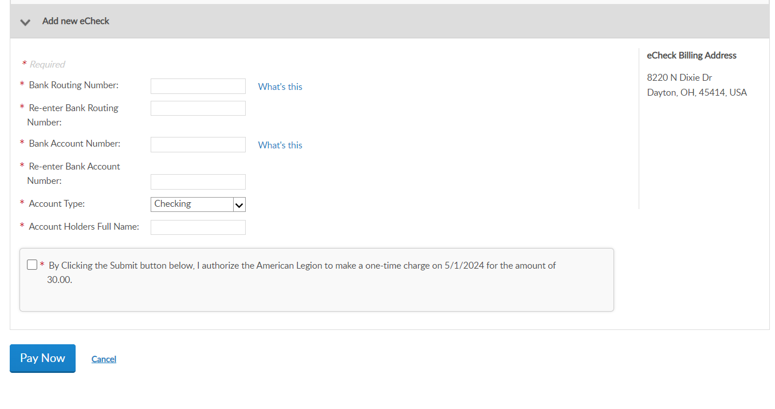
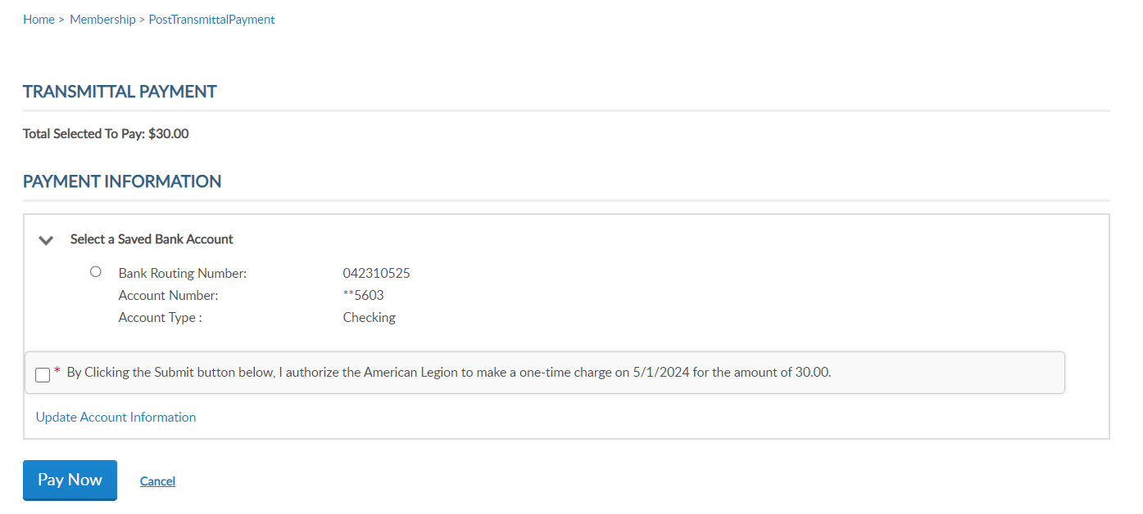
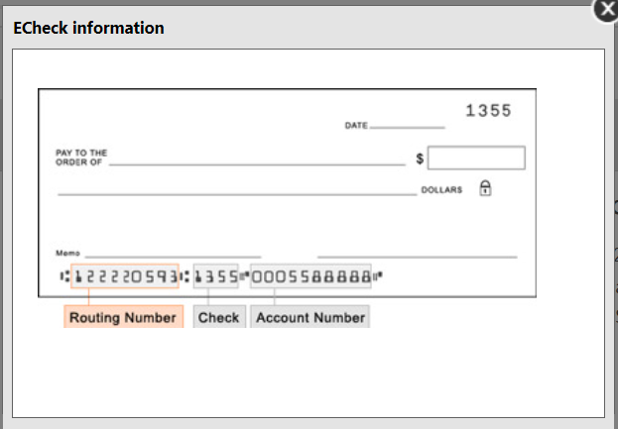
OH Squadron 0668
By Clicking the Submit button below, I authorize the American Legion to make a one-time charge on 4/25/25 for the Amount of 30.00.
By Clicking the Submit button below, I authorize the American Legion to make a one-time charge on 4/25/25 for the Amount of 30.00.
Notes:
Payment information must be entered when finalizing your first transmittal. Enter the routing and bank account information. The Account Holder’s name is the name of the post or squadron bank account. When entering, use a specific description instead of a generic name as in American Legion Post 1.
<1> The easiest place to find your bank’s routing number is to look at your paper checks. The check will typically have the 9-digit routing number down on the bottom left of the check. All routing numbers are 9 digits.
Foreign posts and squadrons can process membership with a credit card. Online membership processing is designed for payment to be processed with a post or squadron account and not with individual credit cards.
The only payment method for US posts is eCheck. Enter the bank account information, authorize the one-time charge by clicking the checkbox and Pay Now.
This information will be stored for future transmittals. Entering new payment information holds future transmittal from finalizing until the first transmittal completes. This is to ensure all subsequent transmittals have valid bank information.
Account information is stored for following transmittals. Finalizing the next batch opens a window with stored account information. <2> Click the authorization box and click Pay Now.
If you receive an error when entering payment information, contact your financial institution to verify ACH payment account information.

Slide 22
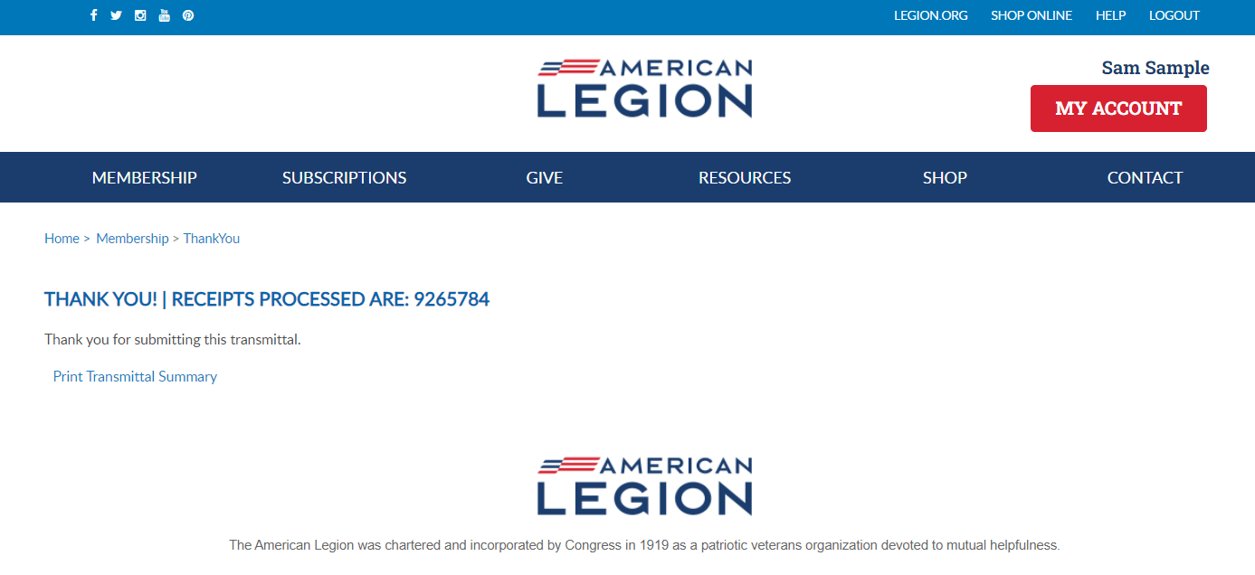
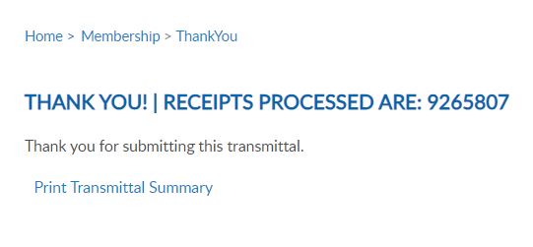
Online Help
Notes:
Finalization of a transmittal produces a receipt number. This is notification the transmittal has been received and is in process. While in pending status, counts are added to the National Target Date membership reports and are immediately available for Departments to add to their membership reports. Members do not receive renewal notices and it prevents them from renewing online that creates duplicate payments.
To view the transmittal summary, and print the receipt, click Print Transmittal Summary.

Slide 23
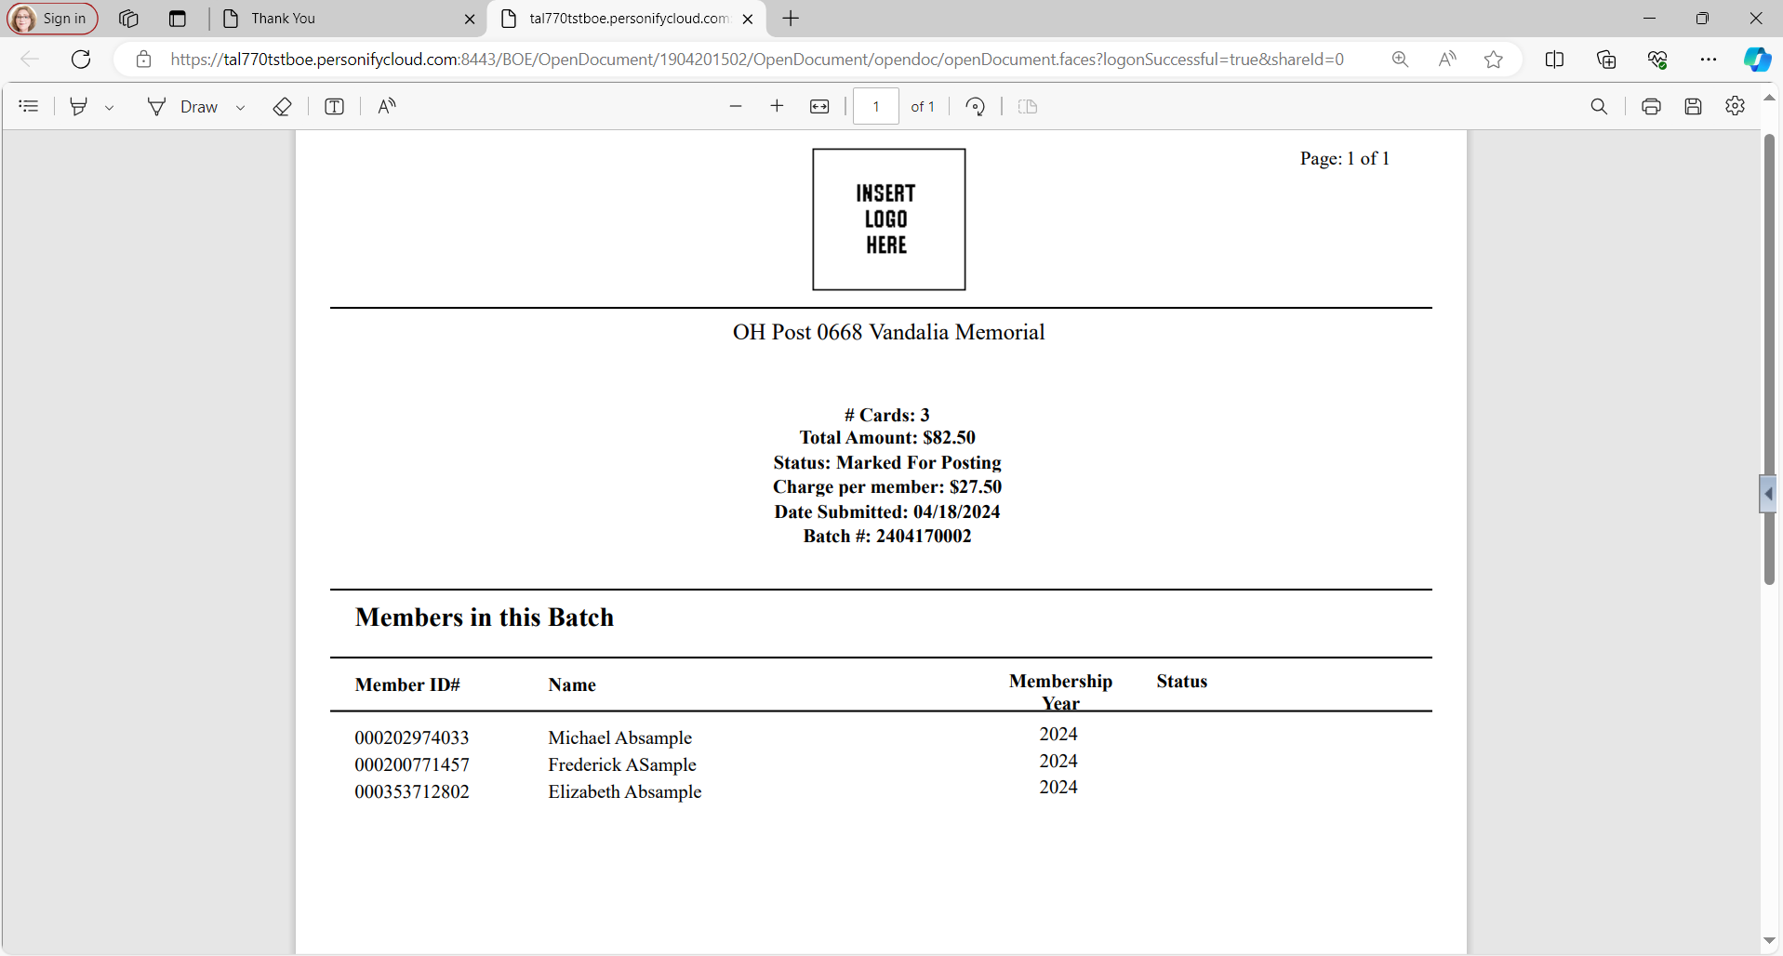
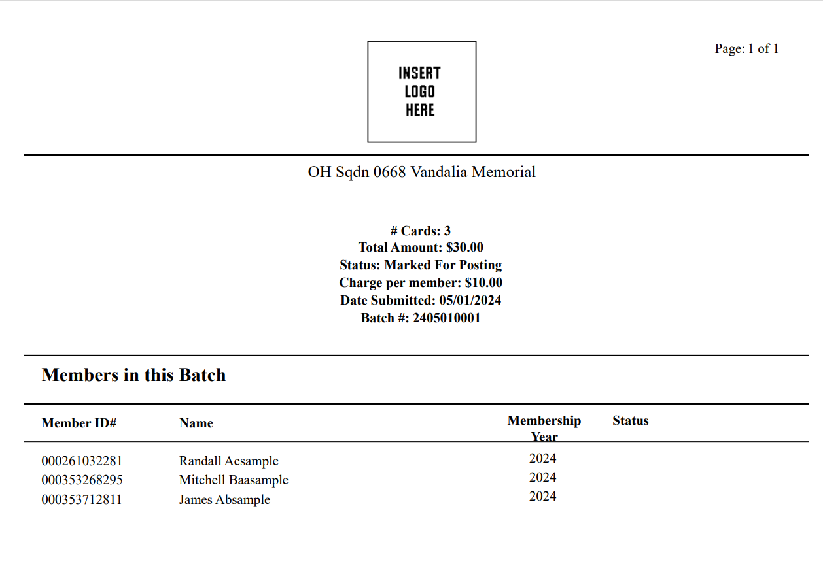

# Cards: 3
Total Amount: $30.00
Status: Marked for Posting
Charge per member: $10.00
Date Submitted: 04/25/2025
Batch #: 2504250001
122333400
2025
2025
2025
124654123
351222333
Notes:
The receipt opens in another tab to print or Save this document for your records. This information is also available in your transmittal history.

Slide 24
Notes:
Return to your group profile to view transmittal status and history. Go back to My Account > My Groups.

Slide 25
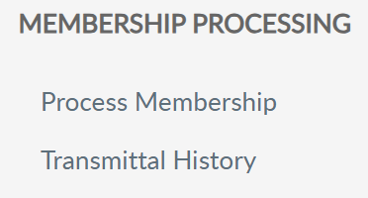
TRANSMITTAL HISTORY
Notes:
Go to Transmittal History to review pending and completed batches. Transmittal history includes reference number, membership year, status, actual number of members submitted and total amount.

Slide 26
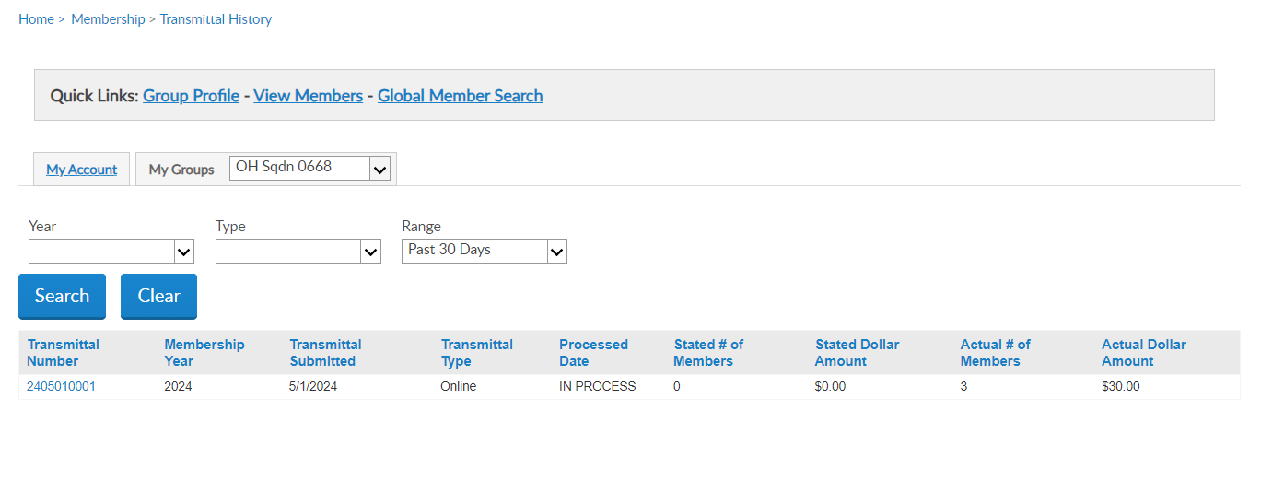
TRANSMITTAL HISTORY
2025
04/25/2025
Notes:
Using the Range search field, you can alter the history displayed. Custom range pulls up date fields to set the range of history. Online transmittal history is only available from April 1, 2021 to current.
Clicking on the transmittal number opens details including members in the batch, amount and status.

Slide 27
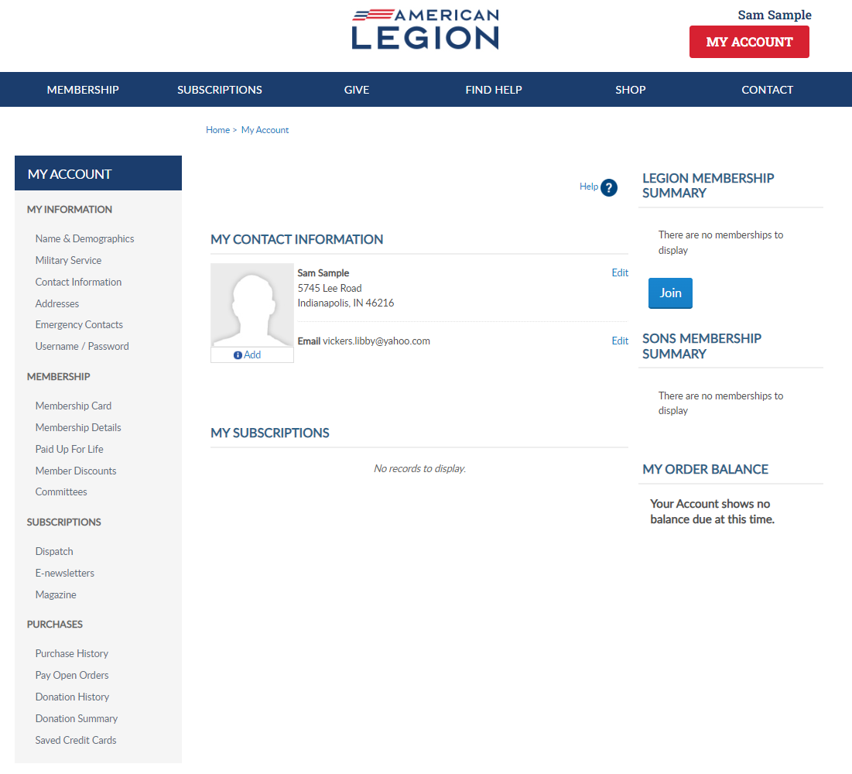
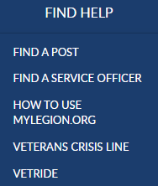
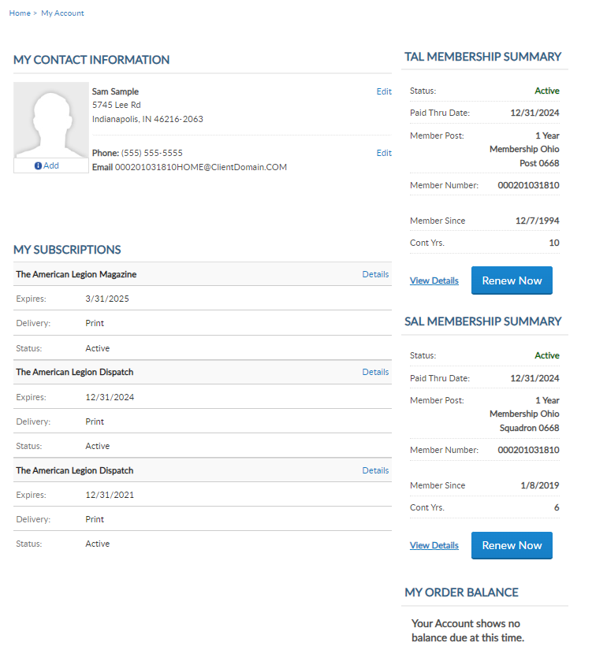
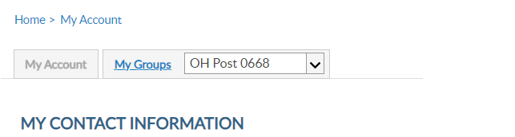
Online Help
987654321
987654321
Notes:
Online help is available from the top Menu “Find Help”.
Step by step instructions, videos and training presentations will assist with how to manage groups in MyLegion.

Slide 28
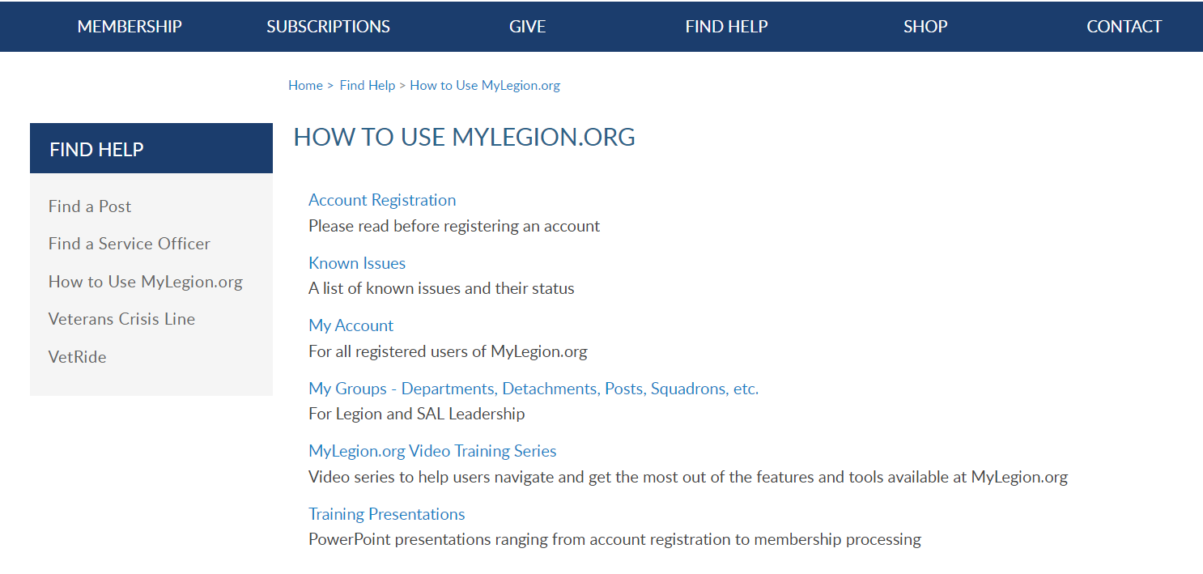
Online Help
Notes:
Step by step instructions, videos and training presentations will assist with how to manage groups in MyLegion. My Groups instructions include managing membership, online, membership processing, reports and all other administrative tasks.

Slide 29
MYLEGION SUPPORT
MyLegion@legion.org
833.253.9995
Monday – Friday
8:00am – 4:30pm
(Eastern)
The American Legion National HQs
5745 Lee Road
Indianapolis, IN 46216
Contact your MyLegion support team to assist with any questions or tools on your MyLegion account.
Notes:
Contact your myLegion support team to assist with questions and tools for MyLegion. Email mylegion@legion.org or call 833-253-9995 Monday through Friday.

